Slide 1
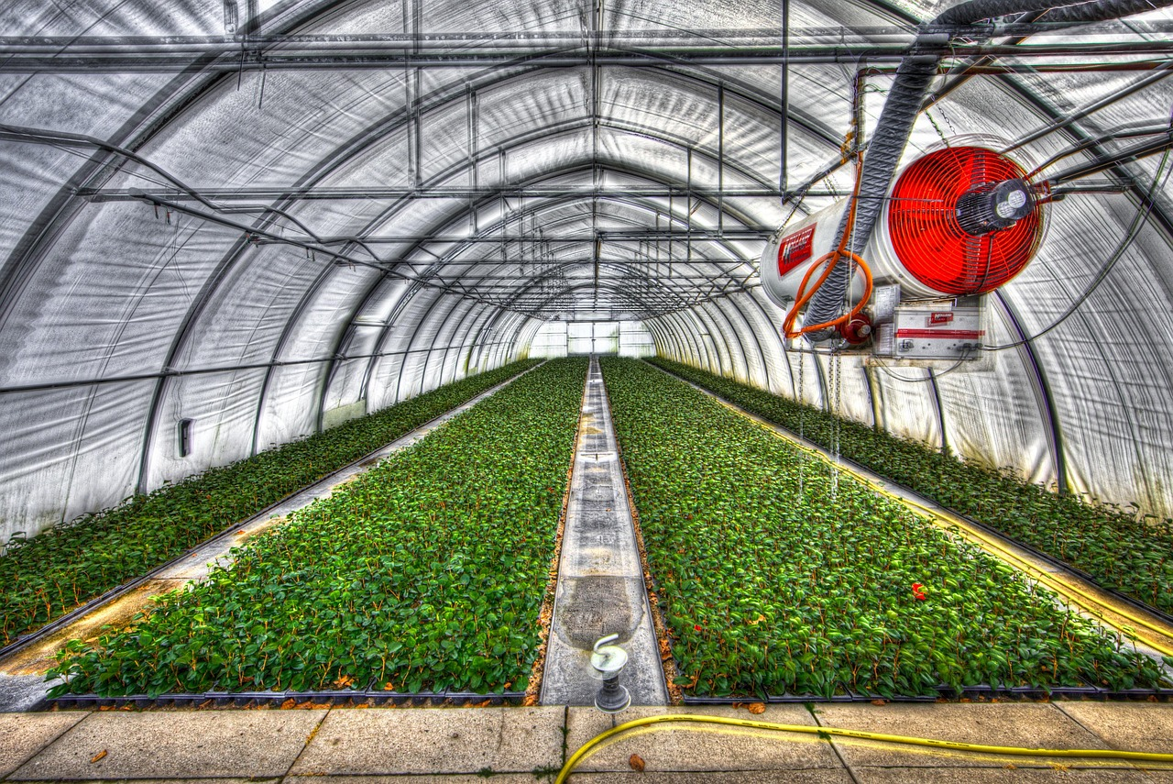

A STUDY ON CONTROLLED-ENVIRONMENT AGRICULTURE
Greenhouse Crop Production
Data-Driven Analysis of Yield, Climate & Cultivation Practices
NAME
COLLEGE NAME
Jasdeep Singh Dhami
Rayat Bahra Group Of Institute And Nano Technology Hoshiarpur
STREAM / COURSE
ROLL NO.
B.tech(AI&ML)
2449388

Slide 2

Greenhouse Crop Production
2

Slide 3
AGENDA
Table of Contents
01
Introduction
06
Dashboard & Visual Analysis
02
Problem Statement
07
Key Insights
03
Project Overview
08
Conclusion
04
Dataset Overview
09
Future Scope
05
Technology Used
Greenhouse Crop Production
3

Slide 4



GETTING STARTED
Introduction
Why we use greenhouse crop data ?
Greenhouse crop data helps farmers make smarter decisions by using sensor information to control water, temperature, humidity, and fertilizer. Proper use of this data reduces waste, improves crop quality, and increases overall production and profit.
This project analyzes real greenhouse operations data to understand how environmental and nutritional factors shape crop yield.
Sensor data is collected but not fully used ->
For example, sensors measure temperature, humidity, and soil moisture, but farmers may not analyze all the information.
Focus Crops
Tomato • Cucumber • Pepper • Lettuce
5
10,400
Chances to improve the greenhouse are missed ->
Because the collected data is not used properly.
Water may be given when plants do not need it.
Temperature settings may not be adjusted at the right time.
Fertilizer may be used more than required.
Greenhouses studied
Crop growth records
Greenhouse Crop Production
4

Slide 5



THE CHALLENGE
Problem Statement
Greenhouse growers manage dozens of interacting variables — temperature, humidity, CO2, light, irrigation and fertilizer dosage — often relying on experience rather than data. Without a clear understanding of which factors most influence yield, resources are wasted and yield potential is left on the table.
Inconsistent Yields
Pest & Climate Risk
Fertilizer Guesswork
Two greenhouses set up almost the same way can produce wildly different harvests — as little as 0.1 kg or as much as 30.6 kg of produce per square meter.
When bugs show up or the temperature swings, nobody's really tracking how much that actually hurts the harvest. So growers can't tell which risks matter most.
Instead of giving each crop the exact nutrient mix it needs to thrive, growers often just use a one-size-fits-all fertilizer plan — which wastes money and doesn't optimize growth.
Greenhouse Crop Production
5

Slide 6





THE APPROACH
Project Overview
This project applies data analysis to a real-world greenhouse operations dataset to uncover the relationships between environmental conditions, cultivation inputs, and final crop yield — turning raw sensor and farm-log data into actionable growing guidance.
1
2
3
4
5
Collect
>
Clean & Process
>
Analyze
>
Visualize
>
Recommend
Consolidate 10,400 greenhouse growth records across 4 crops
Handle missing values, standardize units, engineer features
Correlate climate & nutrient variables against yield
Build a dashboard of key production metrics
Translate insights into practical growing guidelines
Objective: Identify the factors that most strongly drive yield, and quantify their impact for each crop type.
Greenhouse Crop Production
6

Slide 7
THE DATA
Dataset Overview
10,400
20
4
5
Total Records
Variables Tracked
Crop Types
Greenhouses
Key Variables Captured
Climate: Avg / min / max temperature, humidity, CO2, light intensity, photoperiod
Cultivation: Planting & harvest dates, days to maturity, irrigation (mm)
Nutrition: Fertilizer N, P, K dosage (kg/ha)
Health & Soil: Pest severity index, soil pH
Outcome: Yield (kg per m²) — the target variable
Greenhouse Crop Production
7

Slide 8




OBJECTIVES
What This Study Sets Out to Do?
Profile the Data->
Summarize distributions and detect outliers across temperature, humidity, CO₂, light and yield readings
Map Relationships ->
Examine correlations between climate variables and crop yield .
Identify Optimal Ranges->
Pinpoint the climate conditions associated with the highest recorded yields.
Generate Actionable Insight ->
Translate patterns into recommendations that inform greenhouse climate control strategy.
Greenhouse Crop Production
8

Slide 9


TOOLKIT
Technology Used
Python
Pandas & NumPy
Matplotlib / Seaborn/Plotly express
Core language for data cleaning, transformation and analysis
Data wrangling, aggregation and statistical computation
Exploratory charts and correlation visualizations
Excel / CSV
Jupyter Notebook
Streamlit
Raw dataset storage and initial inspection
Interactive analysis and iterative experimentation
used to build interactive graphs and dashboards for data analysis and visualization
Greenhouse Crop Production
9

Slide 10
VISUAL ANALYSIS
Production Dashboard
Greenhouse Crop Production
10

Slide 11
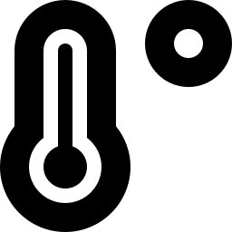
FINDINGS
Key Insights
Tomato leads in yield
Nitrogen is the strongest driver
Tomatoes produce way more per square meter than lettuce (over double).
Out of everything they tracked, Nitrogen has the strongest relationship with good yields. Potassium is a close second. So if you want to boost yield, fertilizer especially nitrogen is your biggest lever
Temperature matters, moderately
Greenhouse performance is fairly uniform
Higher temperature is linked to better yields, but the connection is only moderate .Warm-loving crops like tomatoes and peppers benefit most.
Average yield across the 5 greenhouses ranges narrowly from 12.21 to 12.60 kg/m², suggesting consistent management.
Greenhouse Crop Production
11

Slide 12
LOOKING AHEAD
Conclusion & Future Scope
Conclusion
Key Advantage
EDA revealed that soil moisture and temperature are the leading drivers of greenhouse crop yield, with clear optimal ranges emerging from the data — insight that was invisible in the raw sensor logs alone.
.
A structured, visual approach to the data surfaced actionable patterns quickly, without requiring a predictive model to get started.
Future Work
Automated Climate Control
Use insights to drive automated irrigation and fertigation systems, reducing manual intervention.
Planned extensions include predictive yield modeling, real-time anomaly detection, multi-season comparisons, and integration with automated climate-control systems.
Greenhouse Crop Production
12

Slide 13
Thank You
Greenhouse Crop Production
13

